Slide 1
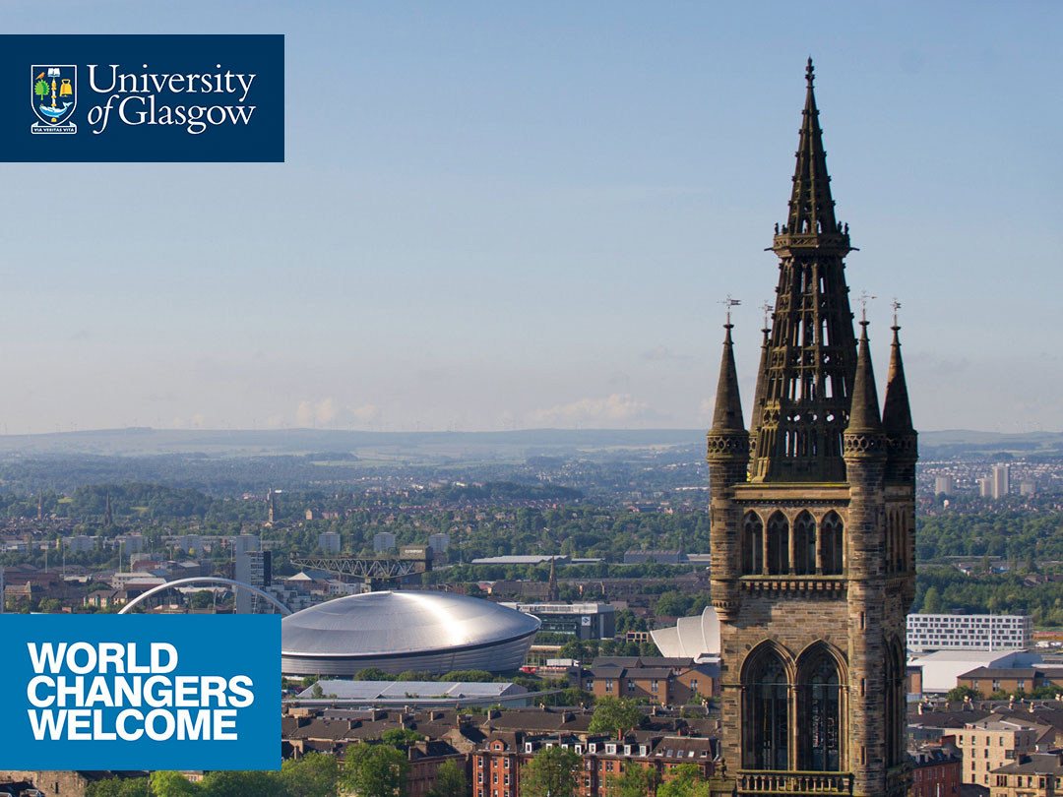
Batch process of images
Image J plugin with Macro
Zonghan Gan
Division of Biomedical Engineering
University of Glasgow

Slide 2

Filter, Merge, Scale bar for each image
Present same operation for all images

Slide 3
Realize- Macro
Specified programming language for ImageJ/ Fiji, calling existed functions
Realized by using loop in macro\
Scale bar parameters comes from your own measurement! Specified the scale bar parameters and filters you required.

Slide 4
Loop in Macro
Very rigid, only loop with number
Cannot generate new path, depend on existed path
Need another external tool to code (rename) images with number and decode back——Avanced Renamer
The data structure of the fluorescent images taking with the Zeiss software : eg. D:\path\image name\pos 0\imag000.tiff, imag001.tiff, and imag002.tiff (RGB channels)

Slide 5
General process
When taking an image with the Zeiss software, capture channels in sequence—Green, Red, Blue, then click save as separate images.
Code (Rename) the folder of each images according to number,; create path for input and output
Run the plugin in ImageJ/ Fiji
Decode (Rename back) the names of the images (final results in the output folder)
Pick up best image and manually adjust color balance

Slide 6
Specified filter for gel sample——FFT-bandpass filter
Very hard for noise to remove—saturated noise
Different filter—not from intensity, but from spatial distribution
More flexible with macro than manually, realize one-side filter instead of bandpass
https://imagej.nih.gov/ij/plugins/fft-filter.html

Slide 7
The source code today can be found on my Github.
https://github.com/Zonghan-Barry-Gan/Zonghan-Barry-Gan
Example Video recorded how to use the plugin
www.youtube.com/watch?v=ipekg863kek&list=UUzjqC0QFICi3xyqVpwQg9pw

Slide 8
Thanks!

